Slide 1



JavaScript ES6 – Iterators & Generators
Mark J. Buckler
OCPJP,CIWJS

Slide 2

Credits
Some of the contents of this slide presentation have been referenced and reproduced, from Switching to ES6 in Node.js, by Ryan Lewis, ©2017 LinkedIn Corporation.

Slide 3
LEARNING OBJECTIVES
Iterating Through Collections
Generators
for…of and Generators

Slide 4

Iterating Through Collections
ES5 Iteration
Navigating through a collection from a starting point to an ending point: like an array
One ES5 method is to use a standard for loop for indexed arrays
Another uses the array object method array.forEach()
Another uses the for…in construct to obtain the key to each element, which is then used for access

Slide 5
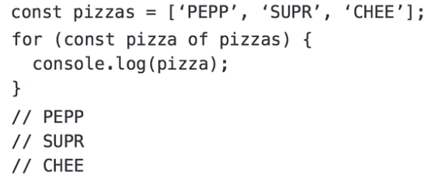
Iterating Through Collections
ES6 Iteration
Introduces a new construct: for…of
Easiest of all the iteration methods
Can be used with all iterable types, such as Array, Map, and Set
Not with objects, which are not iterable

Slide 6
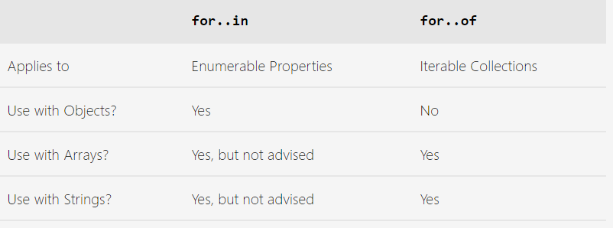
Iterating Through Collections
ES6 Iteration
for…in vs for…of

Slide 7
Iterating Through Collections
When to Use a for…of Construct
When iterating over an Array, Map, or Set
In those instances when you do not need the value of the array index for something
You can convert objects to arrays with the object.values()method

Slide 8
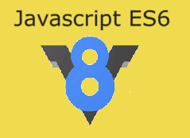
Iterating Through Collections
Programming Exercise03_04_01 – Step 1
Using the for…of Construct

Slide 9
Generators
Generators
Can pause execution of a function, then restart it later
Special functions whose execution can be started or stopped at will
Inspired by iterators
Used in OOP languages like Java, C++, and C#
Used to iterate through collections, of which these languages have many types
Use methods like .next()and .hasNext()to move to the next element in a collection

Slide 10
Generators
Execution Sequence of Generators
Generators use .next() to start/continue code execution
Instead of iterating to another element, it continues execution of that generator
Generators use the new ES6 keyword yield to stop execution of a generator function
Calling .next()executes the code in the function until the next yield keyword or done
.next calls continue from the previous stop point until the next yield

Slide 11
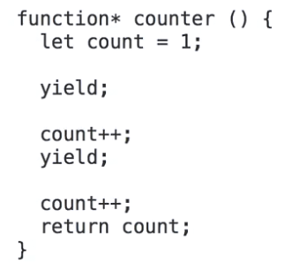
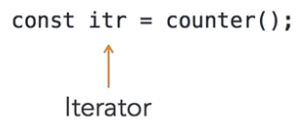
Generators
Generator Syntax
Created by using the function keyword in combination with an asterisk ( * )
The iterator is created by calling the function and assigning it to a variable

Slide 12
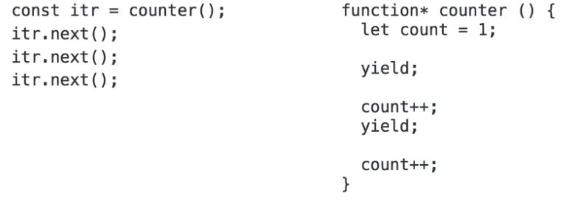
Generators
Running the Generator
The function execution is started and stopped by calls to the .next() method of the created iterator

Slide 13
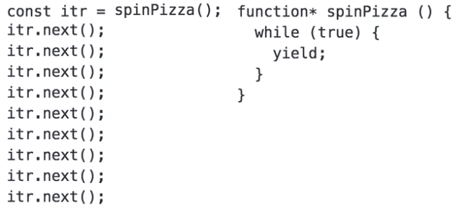
Generators
Running the Generator
The yield keyword can even be used to control loop execution inside a generator function

Slide 14
Generators
Communication with Generator Iteration
The most powerful use of generators is the ability to pass data to and from the generator during execution
Pass data into the generator as an argument to .next()
Receive the data into the next yield
Pass data from the generator with a statement to the right of the yield
Much like a return, but pauses the function, does not end it

Slide 15
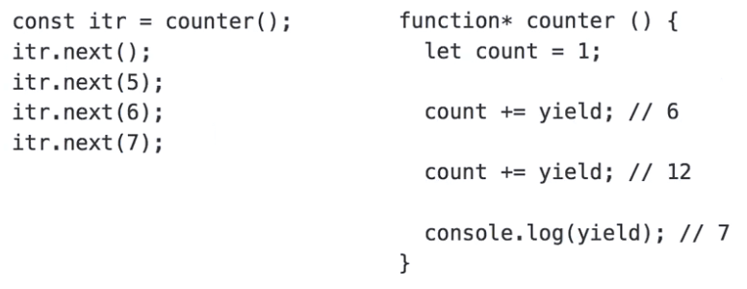
Generators
Running the Generator
Using .next()with arguments

Slide 16
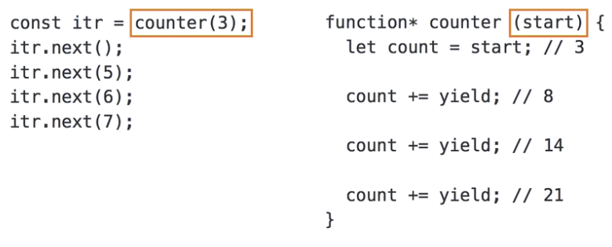
Generators
Running the Generator
Passing initial values to generators

Slide 17
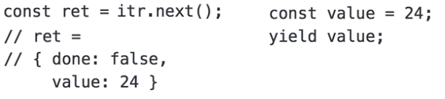
Generators
Running the Generator
Returning values with yield produces an object with two properties, done and value
done is set to false if there is more code to execute
done is set to true if there is no more code to execute
value is then set to the result of a regular return

Slide 18
Generators
Programming Exercise03_04_01 – Step 2
Using Generators

Slide 19
for…of and Generators
Revisiting for…of
The for…of construct can be used to iterate through any iterable object
The objects we have seen so far are Array, Set, and Map
Generators also produce iterators when called
Therefore they can be used in conjunction with the generator

Slide 20
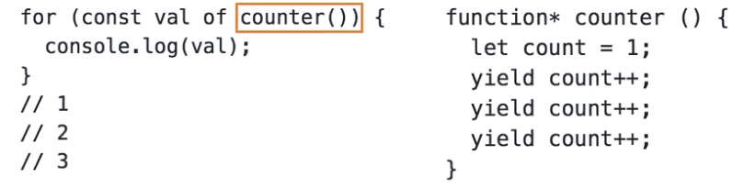
for…of and Generators
Revisiting for…of
counter()returns an iterator
Each iteration of the loop does a .next call
The yield value is returned as the loop variable
Only restriction is the inability to pass parameters with the .next calls
for…of does not pass back any final return from the generator function

Slide 21
for…of and Generators
Programming Exercise03_04_01 – Step 3
Using for...of and Generators

